Slide 1
Segmentations

Slide 2
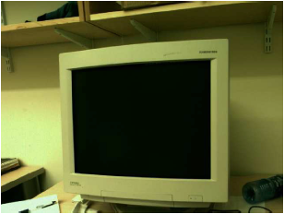
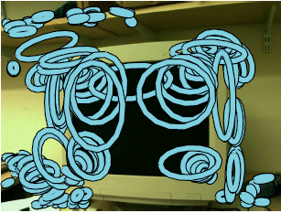
Points
Regions around corners

Slide 3
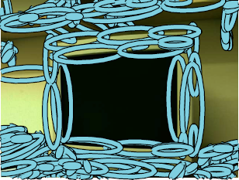
Edges

Slide 4
Regions

Slide 5
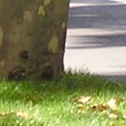
A “simple” segmentation problem
5

Slide 6
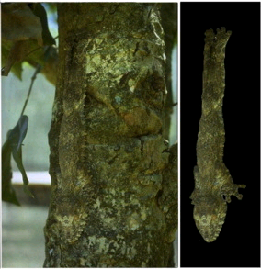
It can get a lot harder
Brady, M. J., & Kersten, D. (2003). Bootstrapped learning of novel objects. J Vis, 3(6), 413-422

Slide 7
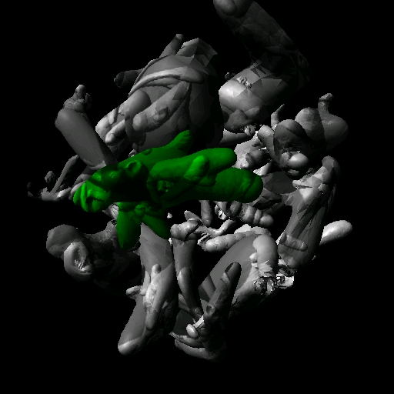
Discover the camouflaged object
Brady, M. J., & Kersten, D. (2003). Bootstrapped learning of novel objects. J Vis, 3(6), 413-422

Slide 8
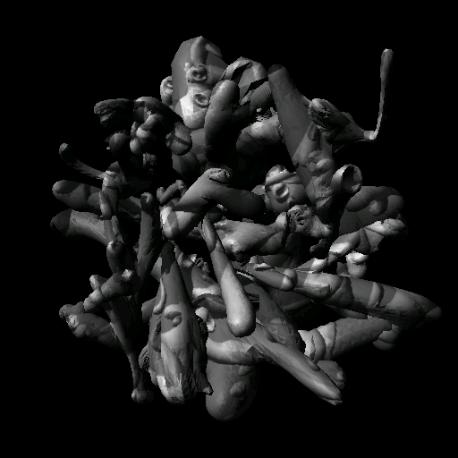
Discover the camouflaged object
Brady, M. J., & Kersten, D. (2003). Bootstrapped learning of novel objects. J Vis, 3(6), 413-422

Slide 9
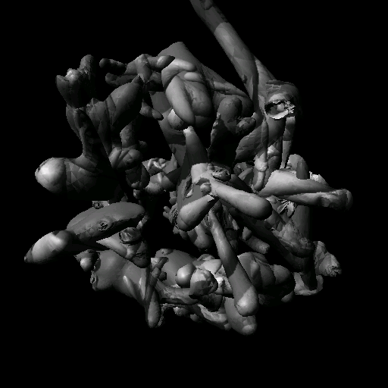

Slide 10
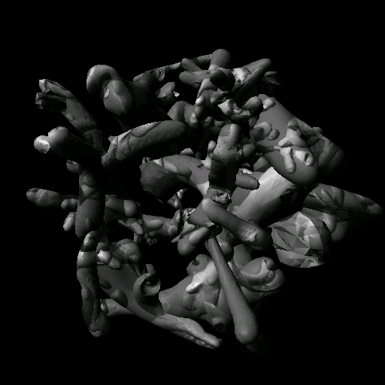

Slide 11
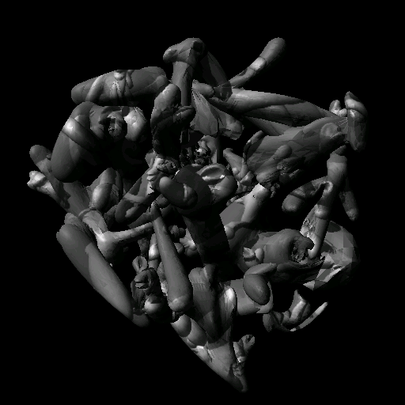

Slide 12
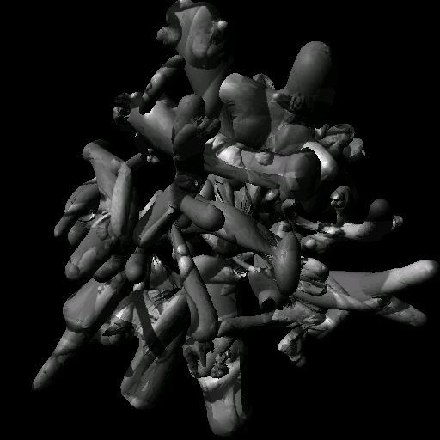

Slide 14
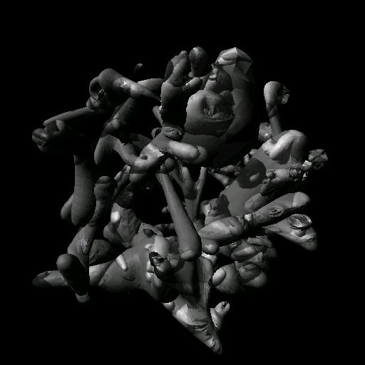
Any guesses?

Slide 16
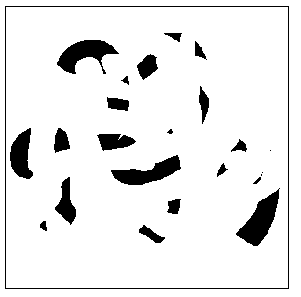
Segmentation is a global process
Notes:
Occlusion cues seem to be very important in grouping. Most people find it hard to read the 5 numerals in
this picture

Slide 17
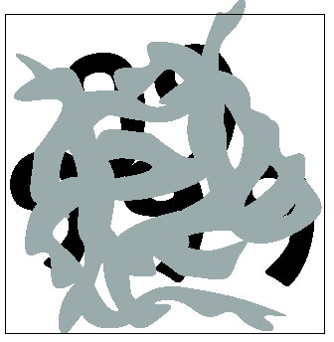
Segmentation is a global process
Occlusion is an important cue in grouping.
Notes:
but easy in this

Slide 18
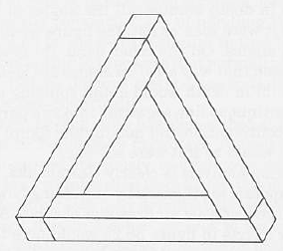
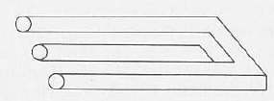
… but not too global

Slide 19
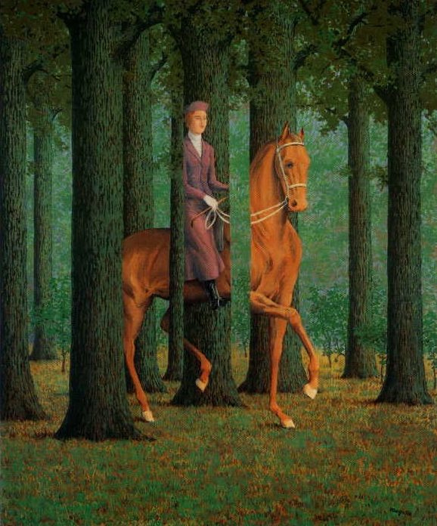
Magritte, 1957

Slide 20
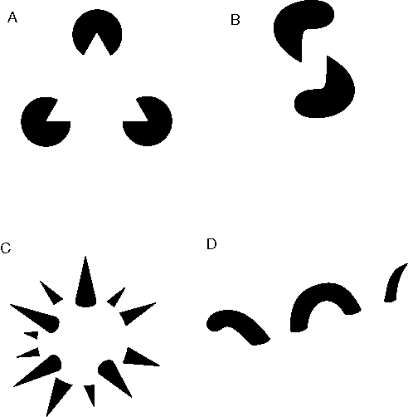
Groupings by Invisible Completions
* Images from Steve Lehar’s Gestalt papers

Slide 21
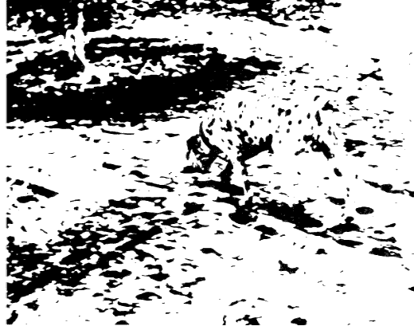
1970s: R. C. James

Slide 22
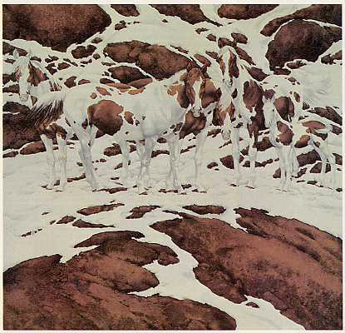
2000s: Bev Doolittle

Slide 23
Perceptual organization
“…the processes by which the bits and pieces of visual information that are available in the retinal image are structured into the larger units of perceived objects and their interrelations”
Stephen E. Palmer, Vision Science, 1999

Slide 24
Gestalt principles
There are hundreds of different grouping laws

Slide 25
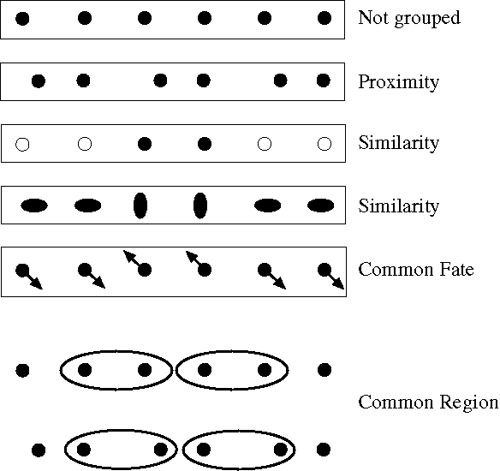
Notes:
Some criteria that tend to cause tokens to be grouped.

Slide 26
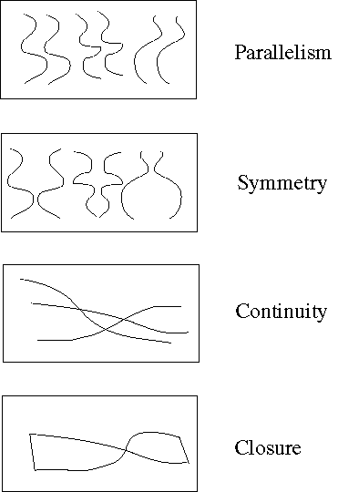
Familiar configuration
Notes:
More such

Slide 27

Familiarity

Slide 28

Familiarity

Slide 29
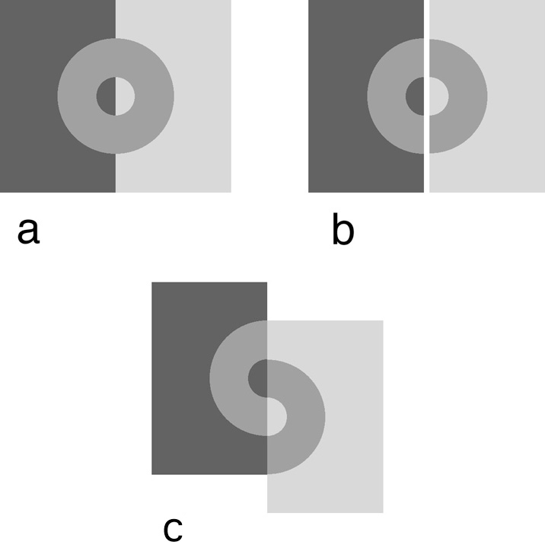
Influences of grouping
Grouping influences other perceptual mechanisms such as lightness perception
http://web.mit.edu/persci/people/adelson/publications/gazzan.dir/koffka.html

Slide 30
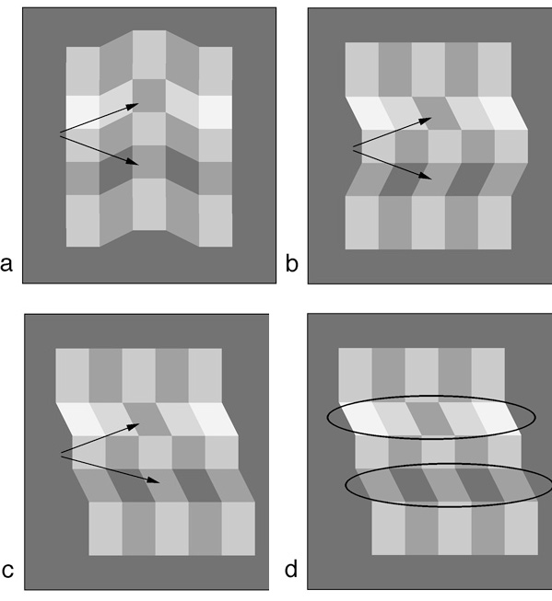
Variations on the corrugated plaid. (a) The two patches appear nearly the same. (b) The patches appear quite different. (c) The patches appear quite different, but there is no plausible shaded model. (d) Possible grouping induced by junctions.
E. H. Adelson, Lightness Perception and Lightness Illusions

Slide 31
Segmentation as clustering
Cluster together (pixels, tokens, etc.) that belong together…
Agglomerative clustering
attach closest to cluster it is closest to
repeat
Divisive clustering
split cluster along best boundary
repeat
Dendrograms
yield a picture of output as clustering process continues

Slide 32
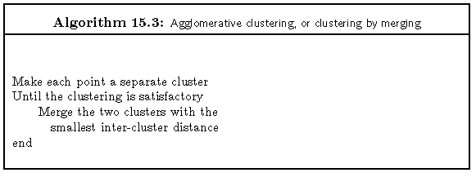
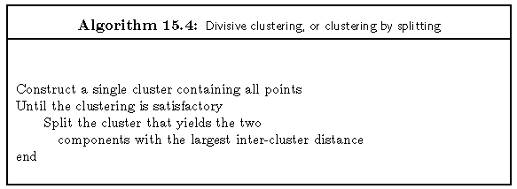
Clustering Algorithms

Slide 33
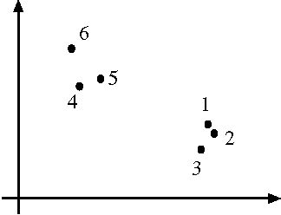
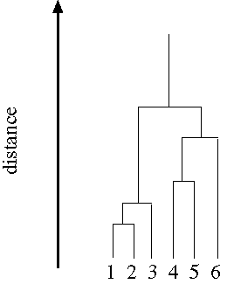
Dendrogram obtained by agglomerative clustering
Data set

Slide 34

A simple segmentation algorithm
Each pixel is described by a vector
z = [r, g, b] or [Y u v], …
Run a clustering algorithm (e.g. K-means) using some distance between pixels: $D(i, j) = {\left\|z_{i}–z_{j}\right\|}^{2}$

Slide 35
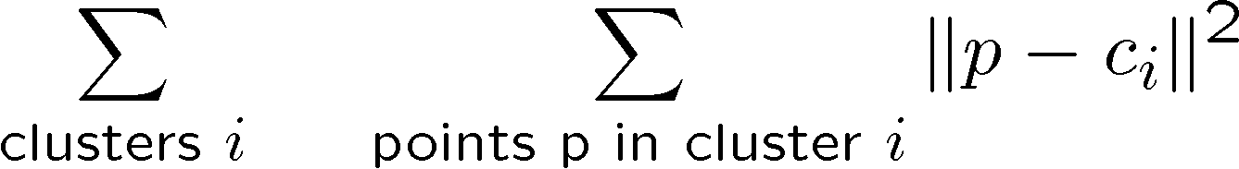
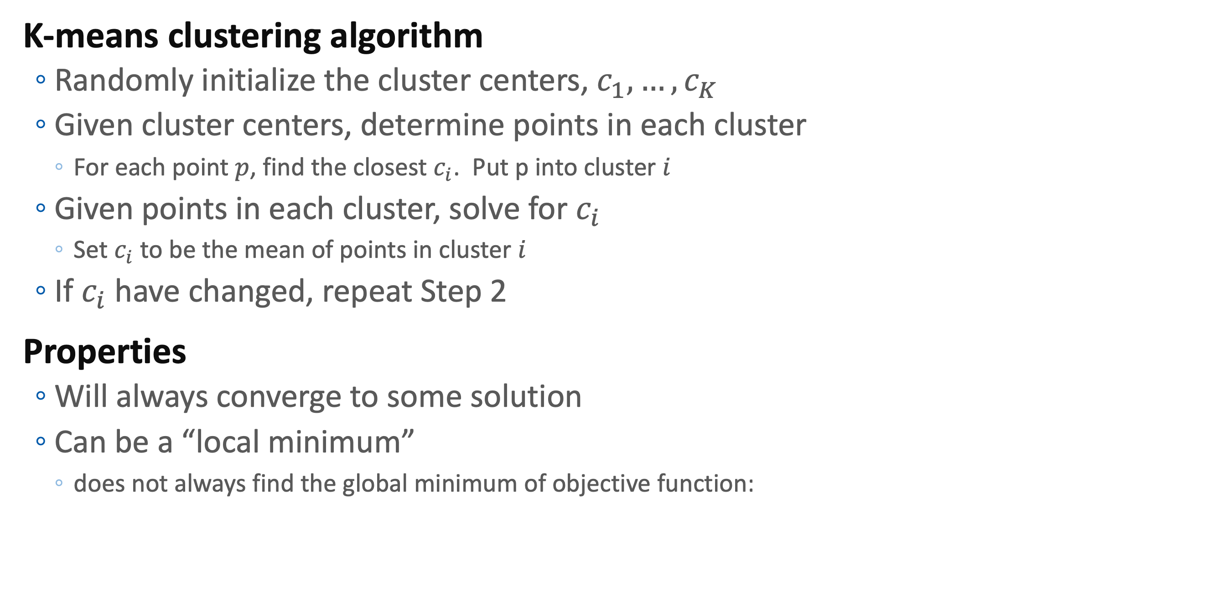
K-Means
K-means clustering algorithm
Randomly initialize the cluster centers, $c_{1}, …, c_{K}$
Given cluster centers, determine points in each cluster
For each point $p$, find the closest $c_{i}$. Put p into cluster $i$
Given points in each cluster, solve for $c_{i}$
Set $c_{i}$ to be the mean of points in cluster $i$
If $c_{i}$ have changed, repeat Step 2
Properties
Will always converge to some solution
Can be a “local minimum”
does not always find the global minimum of objective function:

Slide 36
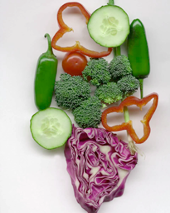
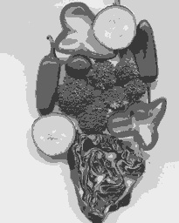
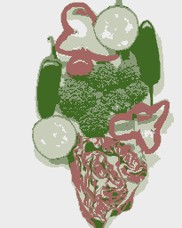
Image
Clusters on intensity (K=5)
Clusters on color (K=5)
K-means clustering using intensity alone and color alone
Notes:
I gave each pixel the mean intensity or mean color of its cluster --- this is basically just vector quantizing the image intensities/colors. Notice that there is no requirement that clusters be spatially localized and they’re not.

Slide 37
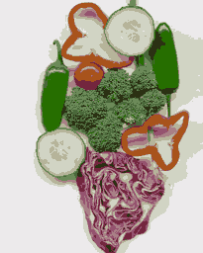
Image
Clusters on color
K-means using color alone, 11 segments

Slide 38


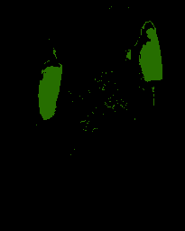
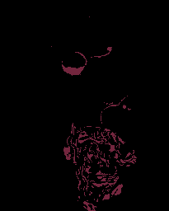
K-means using
color alone,
11 segments.
Color alone
often will not
yeild salient segments!

Slide 39
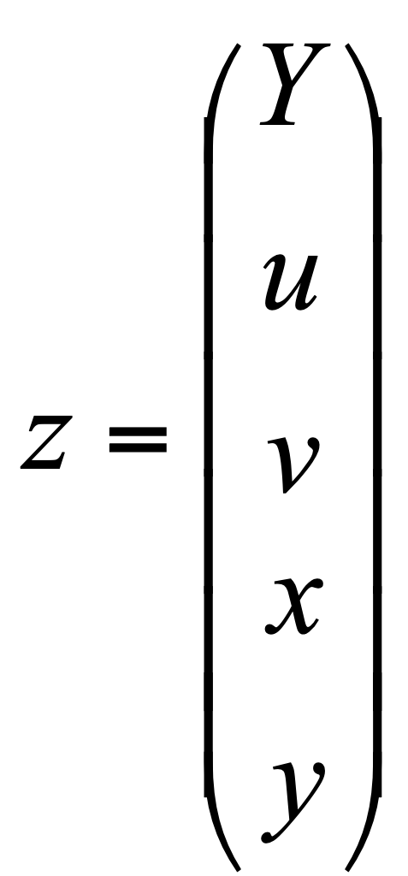
Including spatial relationships
Augment data to be clustered with spatial coordinates.
color coordinates
spatial coordinates

Slide 40

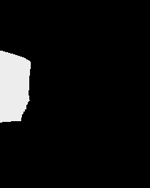



K-means using colour and
position, 20 segments
Still misses goal of perceptually
pleasing segmentation!
Hard to pick K…
Notes:
Here I’ve represented each pixel as (r, g, b, x, y), which means that segments prefer to be spatially coherent. THese are just some of 20 segments.

Slide 41
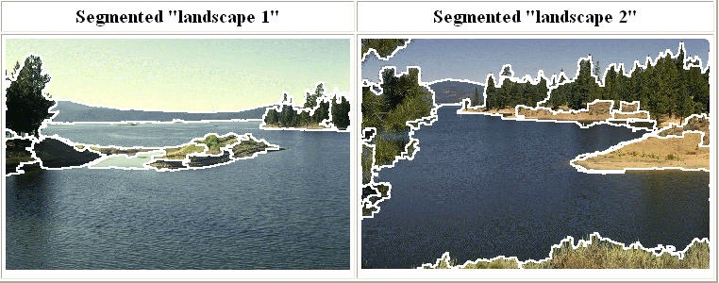
Mean Shift Segmentation
http://www.caip.rutgers.edu/~comanici/MSPAMI/msPamiResults.html

Slide 42
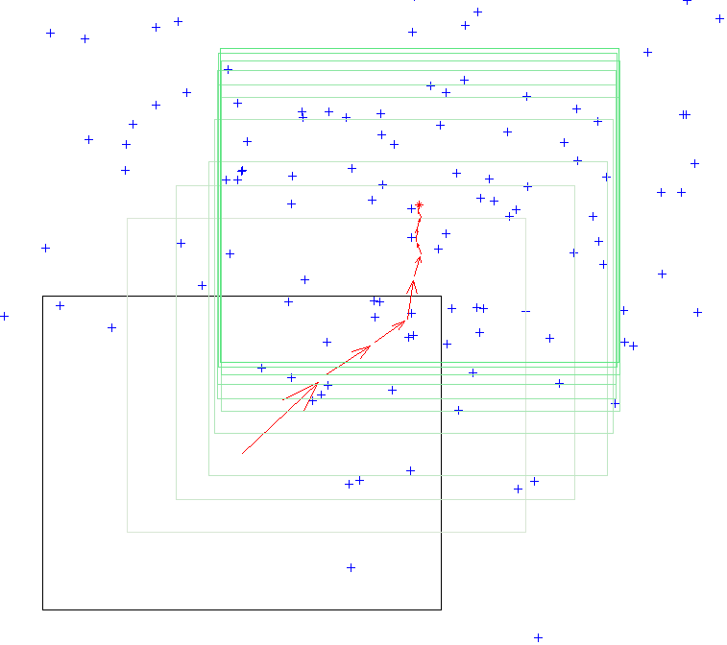
Mean Shift Algorithm
Mean Shift Algorithm
Choose a search window size.
Choose the initial location of the search window.
Compute the mean location (centroid of the data) in the search window.
Center the search window at the mean location computed in Step 3.
Repeat Steps 3 and 4 until convergence.
The mean shift algorithm seeks the “mode” or point of highest density of a data distribution:
Two issues:
(1) Kernel to interpolate density based on sample positions.
(2) Gradient ascent to mode.

Slide 43
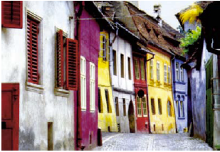
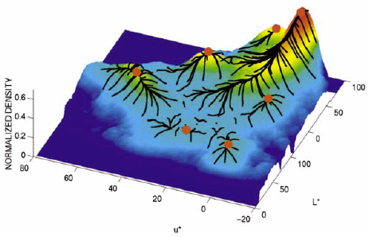
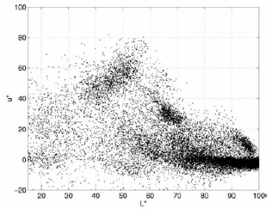
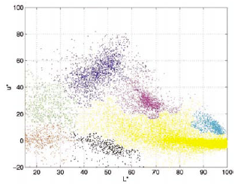
Mean Shift Segmentation
Mean Shift Segmentation Algorithm
Convert the image into tokens (via color, gradients, texture measures etc).
Choose initial search window locations uniformly in the data.
Compute the mean shift window location for each initial position.
Merge windows that end up on the same “peak” or mode.
The data these merged windows traversed are clustered together.

Slide 44
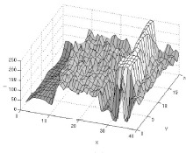

Slide 45
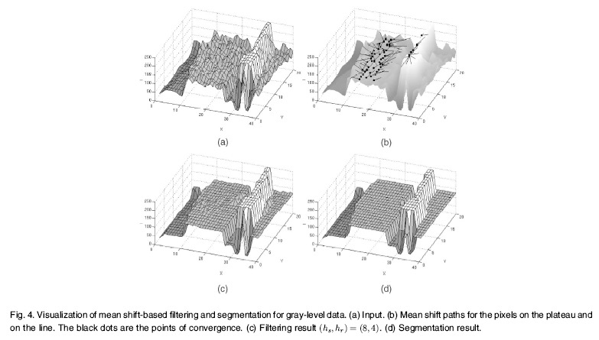
Comaniciu and Meer, IEEE PAMI vol. 24, no. 5, 2002

Slide 46
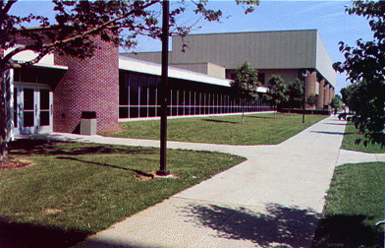
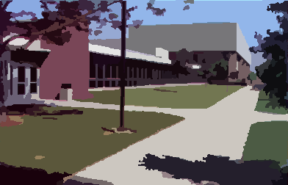
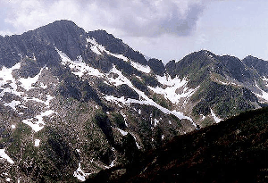

Mean Shift Color & Spatial Segmentation Results:
http://www.caip.rutgers.edu/~comanici/MSPAMI/msPamiResults.html

Slide 47


Mean Shift Color & Spatial Segmentation Results:

Slide 48
A different way
Clustering
grouping pixels
Cutting
connecting similar pixels

Slide 49


Graph-Theoretic Image Segmentation
Build a weighted graph G=(V,E) from image
V: image pixels
E: connections between pairs of nearby pixels
Segmentation = graph partition

Slide 50

Graphs Representations
a
b
c
d
e
a
a
b
b
c
c
e
d
d
e
Adjacency Matrix
* From Khurram Hassan-Shafique CAP5415 Computer Vision 2003

Slide 51


A Weighted Graph & its Representation
Affinity Matrix
a
b
W =
c
e
6
d
* From Khurram Hassan-Shafique CAP5415 Computer Vision 2003

Slide 52

Affinity between pixels
Similarities among pixel descriptors
$$W_{ij} =\exp\left(−\frac{{\left\|z_{i}–z_{j}\right\|}^{2}}{σ^{2}}\right)$$
Scale factor… it will hunt us later

Slide 53


Affinity between pixels
Similarities among pixel descriptors
Interleaving edges
$$W_{ij} =\exp\left(−\frac{{\left\|z_{i}–z_{j}\right\|}^{2}}{σ^{2}}\right)$$
$$W_{ij}=1−max⁡P_{b}$$
Line between i and j
With Pb: probability of boundary

Slide 54





$$W_{ij} = exp⁡(−|| z_{i} – z_{j} ||2 / σ2)$$
With an appropriate σ
W=
The eigenvectors of W are:
Three points in feature space
The first 2 eigenvectors group the points as desired…

Slide 55



Example eigenvector
points
eigenvector
matrix

Slide 56
Example eigenvector
points
eigenvector
matrix

Slide 57

Scale affects affinity
Wij = exp(-|| zi – zj ||² / σ²)
σ=.2
σ=.1
σ=.2
σ=1
Notes:
This is figure 14.18

Slide 58
Global optimization
In this formulation, the segmentation becomes a global process.

Slide 59

Boundaries of image regions defined by a number of attributes
Brightness/color
Texture
Motion
Stereoscopic depth
Familiar configuration
[Malik]

Slide 60




Some Terminology for Graph Partitioning
Cut: sum of the weight of the cut edges:
$$cut\left(A,B\right)=\sum_{u∈A,v∈B}{W\left(u,v\right)} \text{with} A∩B=∅$$
Association: sum of the weights of the edges connecting two sets:
$$assoc\left(A,B\right)=\sum_{u∈A,v∈B}{W\left(u,v\right)} \text{with} A \text{and} B not necessarily disjoint$$
With V = the set of all nodes

Slide 61

Minimum Cut
A cut of a graph G is the set of
edges S such that removal of
S from G disconnects G.
Minimum cut is the cut of minimum weight, where weight of cut <A,B> is given as
$$w\left(\left\langle A,B\right\rangle \right)=\sum_{x∈A,y∈B}{w(x,y)}$$
* From Khurram Hassan-Shafique CAP5415 Computer Vision 2003

Slide 62



Minimum Cut and Clustering
* From Khurram Hassan-Shafique CAP5415 Computer Vision 2003

Slide 63
Drawbacks of Minimum Cut
Weight of cut is directly proportional to the number of edges in the cut.
Cuts with
lesser weight
than the
ideal cut
Ideal Cut
* Slide from Khurram Hassan-Shafique CAP5415 Computer Vision 2003

Slide 64
Normalized cuts
Problems so far
First eigenvector of affinity matrix captures within cluster similarity, but not across cluster difference
Min-cut can find degenerate clusters
Instead,
we’d like to maximize the within cluster similarity compared to the across cluster difference
Write graph as V, one cluster as A and the other as B
Minimize
where cut(A,B) is sum of weights with one end in A and one end in B; assoc(A,V) is sum of all edges with one end in A.
I.e. construct A, B such that their within cluster similarity is high compared to their association with the rest of the graph
cut(A,B)
cut(A,B)
+
assoc(A,V)
assoc(B,V)

Slide 65
Solving the Normalized Cut problem
Exact discrete solution to Ncut is NP-complete even on regular grid,
[Papadimitriou’97]
Drawing on spectral graph theory, good approximation can be obtained by solving a generalized eigenvalue problem.
[Malik]

Slide 66


Normalized cuts
Instead, solve the generalized eigenvalue problem
which gives
They show that the 2nd smallest eigenvector solution y is a good real-valued approx to the original normalized cuts problem. Then you look for a quantization threshold that maximizes the criterion --- i.e all components of y above that threshold go to one, all below go to -b
$$\max_{y}\left(y^{T}\left(D−W\right)y\right) \text{subject} \text{to} (y^{T}Dy=1)$$
$$\left(D−W\right)y=λDy$$
http://www.cs.berkeley.edu/~malik/papers/SM-ncut.pdf

Slide 67




N pixels = ncols * nrows
brightness
location
N
W =
N

Slide 68


Slide 69









Brightness Image Segmentation
http://www.cs.berkeley.edu/~malik/papers/SM-ncut.pdf

Slide 70





Brightness Image Segmentation
http://www.cs.berkeley.edu/~malik/papers/SM-ncut.pdf

Slide 71







http://www.cs.berkeley.edu/~malik/papers/SM-ncut.pdf

Slide 72

Results on color segmentation
http://www.cs.berkeley.edu/~malik/papers/SM-ncut.pdf

Slide 73

Contains a large dataset of images with human “ground truth” labeling.

Slide 74



